Slide 1
MGMT 58600: Python Programming
Lecture 8
Dr. Shoaib Khan

Slide 2
Mathematical and Statistical Methods
NumPy provides a set of mathematical functions that compute statistics about an entire array or about the data along an axis
For example: sum, mean, and std
arr=np.random.randn(5,4)
arr.mean()
arr.sum()
arr.std()
arr.mean(axis=1)
arr.sum(axis=0)
Note: In a 2D array:
axis=0 computes the column-wise function (down each column).
axis=1 computes the row-wise function (across each row).
Functions | Descriptions
median() | return the median of an array
mean() | return the mean of an array
std() | return the standard deviation of an array
percentile() | return the nth percentile of elements in an array
min() | return the minimum element of an array
max() | return the maximum element of an array

Slide 3
Random
NumPy offers the random module to work with random numbers.
Generate a random integer from 0 to 100:
from numpy import random x = random.randint(100) print(x)
The random module's rand() method returns a random float between 0 and 1.
x = random.rand()
Generate random arrays:
The randint() method takes a size parameter where you can specify the shape of an array
x = random.randint(100, size=(5))
x = random.randint(100, size=(3, 5))
The rand() method also allows you to specify the shape of the array.
x = random.rand(5)
x = random.rand(3, 5)

Slide 4
Random
The choice() method takes an array as a parameter and randomly returns one (or more) of the values.
x = random.choice([3, 5, 7, 9])
x = random.choice([3, 5, 7, 9], size=(3, 5))

Slide 5
Random Distributions
A random distribution is a set of random numbers that follow a certain probability density function.
Probability Density Function: A function that describes a continuous probability. i.e. probability of all values in an array.
We can generate random numbers based on defined probabilities using the choice() method of the random module.
The choice() method allows us to specify the probability for each value. (The sum of all probability numbers should be 1.)
x = random.choice([3, 5, 7, 9], p=[0.1, 0.3, 0.6, 0.0], size=(100))

Slide 6
Random Distributions
Use the random.normal() method to get a Normal Data Distribution.
The method has three parameters:
loc - (Mean) where the peak of the bell exists.
scale - (Standard Deviation) how flat the graph distribution should be.
size - The shape of the returned array.
Examples:
x = random.normal(size=(2, 3))
x = random.normal(loc=1, scale=2, size=(2, 3))
Visualization of Normal Distribution (more on this later)
import matplotlib.pyplot as plt import seaborn as sns sns.distplot(random.normal(size=1000), hist=False) plt.show()

Slide 7
Data Selection with Boolean Indexing
In NumPy, Boolean Indexing allows us to filter elements from an array based on a specific condition.
We use Boolean Masks to specify the condition.
A Boolean Mask is a numpy array containing truth values (True/False) that correspond to each element in the array.
Suppose we have an array:
array1 = np.array([12, 24, 16, 21, 32, 29, 7, 15])
Now let's create a mask that selects all elements of array1 that are greater than 20 :
boolean_mask = array1 > 20
Here, array1 > 20 creates a boolean mask that evaluates to True for elements that are greater than 20, and False for elements that are less than or equal to 20
The resulting mask is an array stored in the boolean_mask variable as:
[False, True, False, True, True, True, False, False]

Slide 8
1D Boolean Indexing in NumPy
Boolean Indexing allows us to create a filtered subset of an array by passing a boolean mask as an index.
The boolean mask selects only those elements in the array that have a True value at the corresponding index position.
In the above example: array1[boolean_mask] results in [24, 21, 32, 29]
Now let's see another example.
We'll use the boolean indexing to select only the odd numbers from an array.

Slide 9
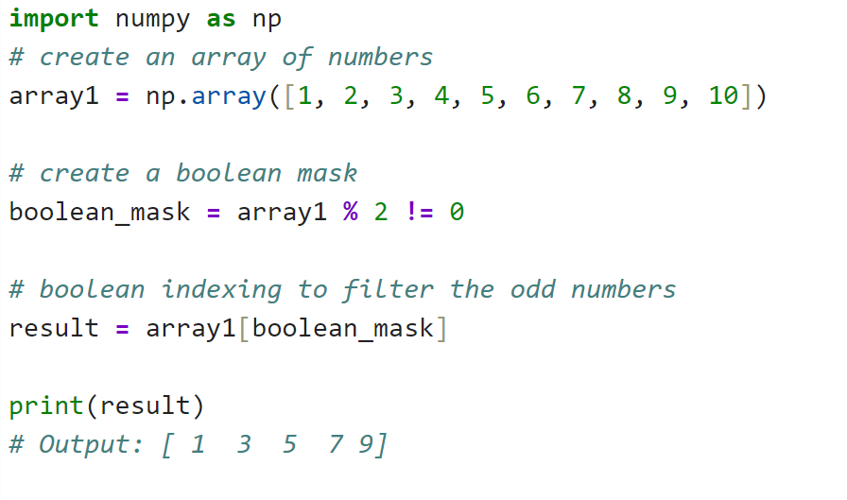
1D Boolean Indexing in NumPy

Slide 10
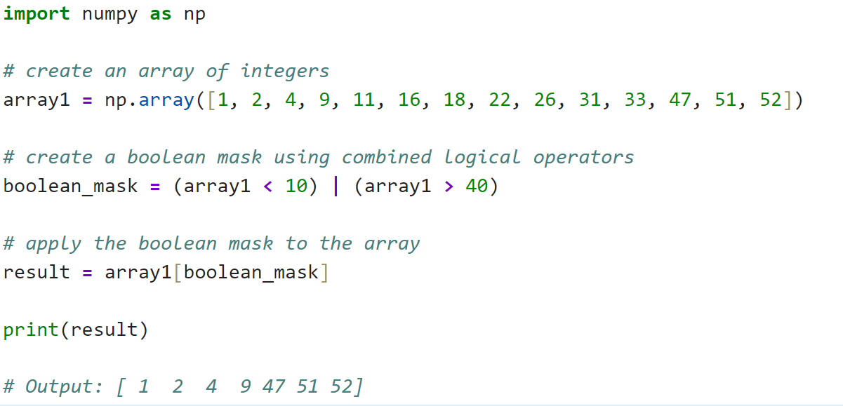
1D Boolean Indexing in NumPy
Here, we have created a boolean mask using the | operator to select all the elements in array1 that are less than 10 or greater than 40

Slide 11
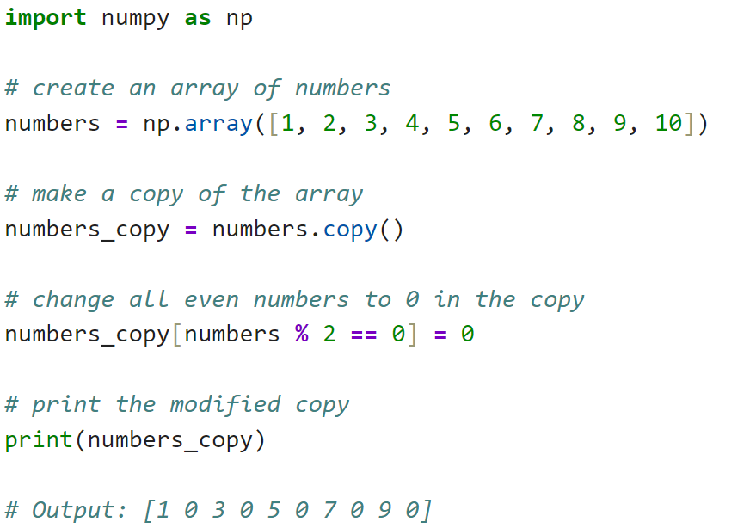
Modify Elements Using Boolean Indexing
In NumPy, we can use boolean indexing to modify elements of the array:

Slide 12
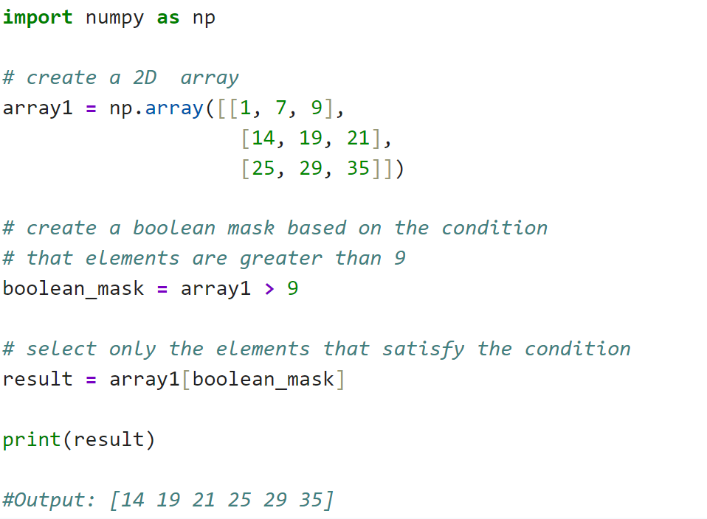
Boolean Indexing in Multi-Dimensional Arrays
Boolean indexing can also be applied to multi-dimensional arrays in NumPy. Here is an example of element wise Boolean indexing in 2D arrays:

Slide 13
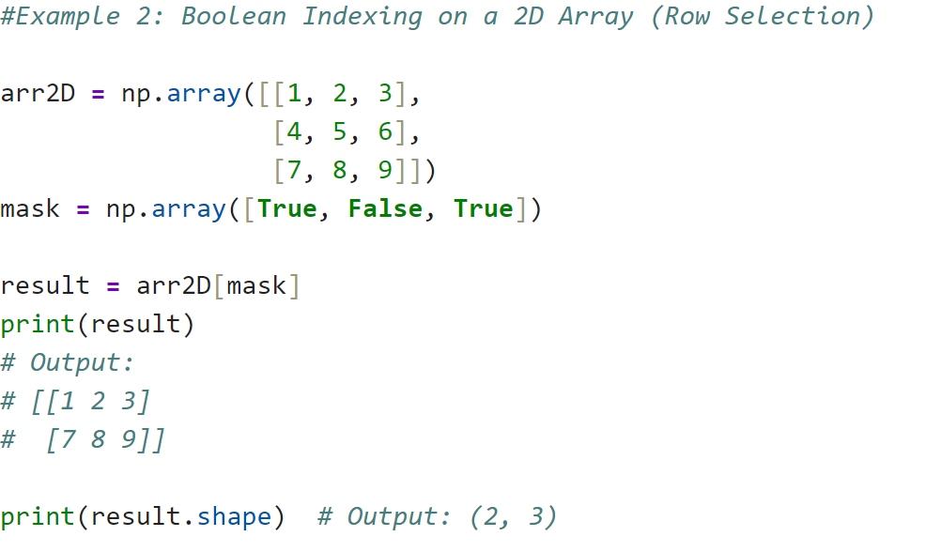
Boolean Indexing in Multi-Dimensional Arrays
Example 2: Boolean Indexing on a 2D Array (Row Selection)

Slide 14
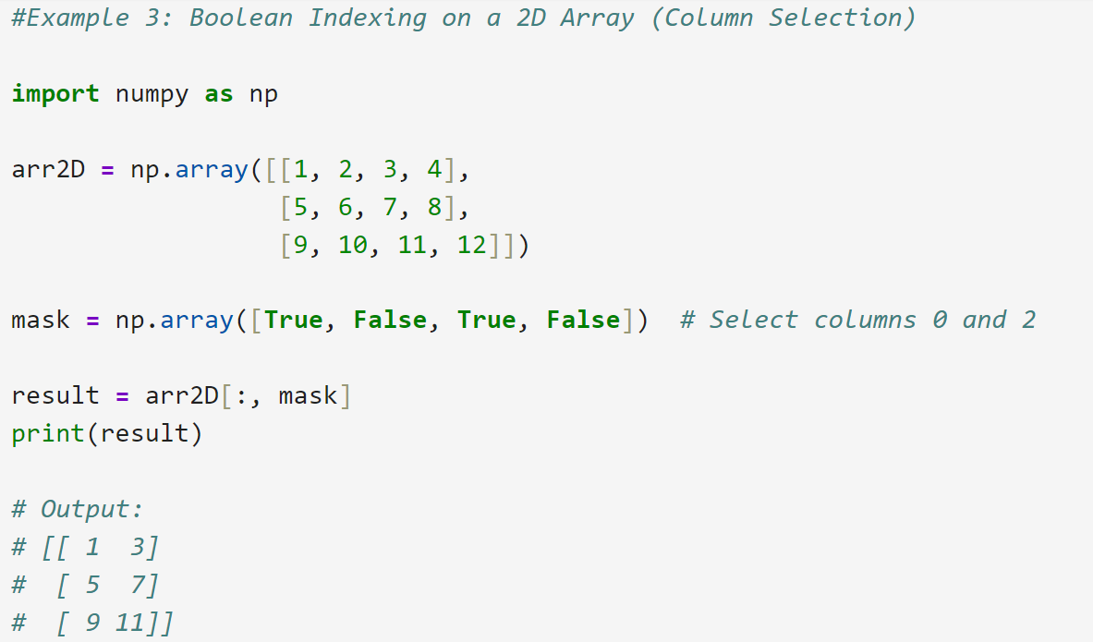
Boolean Indexing in Multi-Dimensional Arrays
Example 3: Boolean Indexing on a 2D Array (Column Selection)

Slide 15
Class Activity
Exploring Applications of Numpy in
Real World Business Scenarios

Slide 16
Scenario: Fraud Detection in Credit Card Transactions
Business Problem: A bank wants to detect potential fraudulent transactions in real time.
They define fraud as transactions that meet at least two of the following criteria:
The amount is higher than $5,000.
The transaction occurs outside regular business hours (before 6 AM or after 9 PM).
The transaction comes from a blocked merchant ID.
Use NumPy to help the bank quickly flag suspicious transactions.

Slide 17
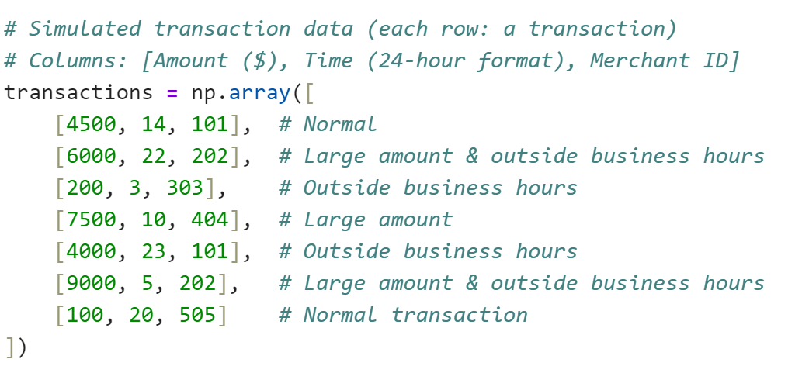
Simulated Transaction Data:

Slide 18
Scenario: Predicting Warehouse Restocking Needs
Business Context:
A logistics company wants to efficiently manage inventory restocking for its warehouses. They need to identify products that require urgent restocking based on:
Current stock level is below 20 units.
Projected demand (based on past trends) is more than 50 units for the next week.
Stock after demand would fall below 10 units after meeting the upcoming demand.
Using NumPy help the company quickly determine which products need urgent restocking.

Slide 19
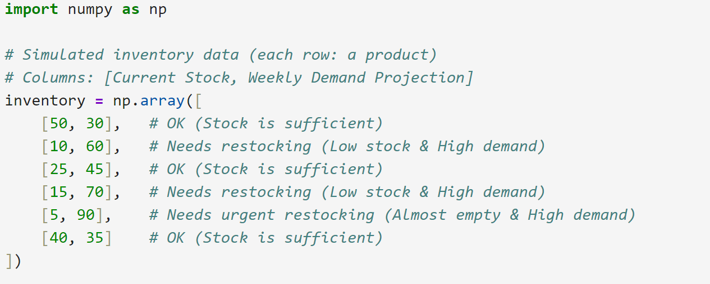
Simulated Inventory Data

